Slide 1
Your Name Goes Here
Link to github Repository: lucas123454653/SMC-SPORTs: qeweqweq (github.com)
Link Microsoft Planner:https://tasks.office.com/Sanctamariacollege.onmicrosoft.com/en-US/Home/Planner/#/plantaskboard?groupId=704115c4-302e-4f74-aa38-187c50e79bb6&planId=wgabDRI2DkG2QZvYXMPm2MgACdiY
Creating:
You MUST provide evidence showing how the problem has been decomposed, how the components have been developed and trialled, and of how they have been assembled and tested to create a final, working outcome.

Slide 2
Design Brief
I plan to create a website that allows students and teachers to write and keep notes, just in case they don't have a book or pen, and need to urgently take notes.

Slide 3
Design Brief
Identify and describe who your clients/stakeholders
(Stakeholders are anyone involved or affected by your project)
The stakeholders for my website will be the students and possibly teachers.
This is because they will be the ones writing the notes and using my site

Slide 4
Design Brief
Your Specifications: (What you want your outcome to have)
my website will be called Notes buddy and should be able to let students create accounts, login, logout, and write notes and be able to delete them.

Slide 5
Design Brief
Client/Stakeholder specifications:(What your stakeholders want the outcome to have)
My client/stakeholder wants a fully functional website that allows students and teachers to store notes safely.

Slide 6
Design Brief
Requirements: (get these from the assessment)
Uses variables storing at least two types of data (e.g. numeric, text, Boolean) Uses sequence, selection and iteration control structures takes input from a user, sensors, or other external source produces output Uses two or more advanced programming techniques below: modifying data stored in collections (e.g. lists, arrays, dictionaries) storing multidimensional data in collections creating methods, functions, or procedures that use parameters and/or return values responding to events generated by a graphical user interface (GUI) using non-trivial string manipulation using additional non-core libraries.

Slide 7
Relevant Implications
You must have at least 3. You can have more if you feel you need to consider more.
A possible implication would be inaccurate data due to the constant change of data
1: aesthetics
2: functionality
3: privacy

Slide 8
Explain the relevant implications
Implication 1
Describe the implication
I want my website to be engaging and aesthetic. I do not want the website to be ugly to look at and be overloaded with information. Everything should be simple and the only information on the website is the ones that are needed.

Slide 9
Explain the relevant implications
Implication 1
Explain why it needs to be considered
This implication needs to be considered because the website needs to look good for all the new users that come onto the website.

Slide 10
Explain the relevant implications
Implication 1
Explain how you plan to address the implication
I will address the implication by making sure the font, colour scheme, and layout match and look good together, I will test multiple to make sure that they all fit well together.

Slide 11
Explain the relevant implications
Implication 2
IMPLICATION 2 – FUNCTIONALITY
The website is fully functional and all the routes and buttons etc do what they're supposed to do and no errors come up for the users.

Slide 12
Explain the relevant implications
Implication 2
Explain why it needs to be considered
The implication of functionality needs to be considered because if the website is not fully functional how can it be used.

Slide 13
Explain the relevant implications
Implication 2
Explain how you plan to address the implication
We plan to address the implication of functionality by having a bunch of people test the website before it comes out, this will ensure all the possible errors will have been fixed up before the website releases.

Slide 14
Explain the relevant implications
Implication 3
Explain the implication:
The third implication will be privacy
We will make sure everyone's privacy and data such as names, emails, phone numbers, and passwords will be respected.

Slide 15
Explain the relevant implications
Implication 3
Explain why it needs to be considered
This needs to be considered because when signing up for the site people could put in sensitive data that if leaked could have a negative effect on their life.

Slide 16
Explain the relevant implications
Implication 3
Explain how you plan to address the implication
We will do this by making sure all the people who are publicly on the website consent to it, we will make sure everyone else's data is respected by making sure the websites data base is secure and unable to be breached, and if so, have a way to make sure the data stays safe with hashes to hide the data.

Slide 17
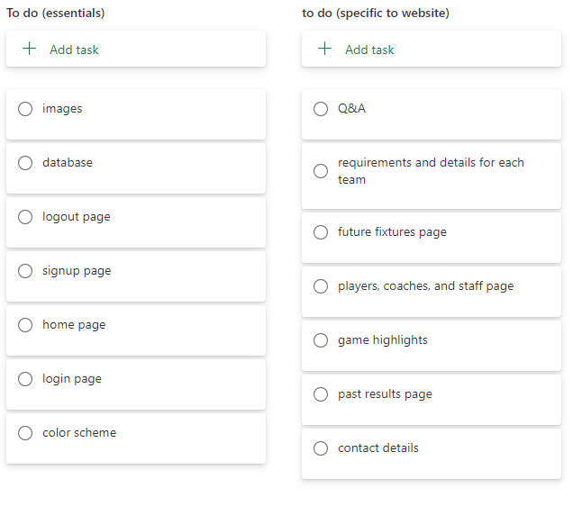
Decomposition

Slide 18
Component Section
Duplicate Slides so that you have a plan and a TEST for each component

Slide 19
Component 1 v1
Test Case | Expected Values
Created the directory structure | All the .py and .html files have been created and put in the correct place.

Slide 20
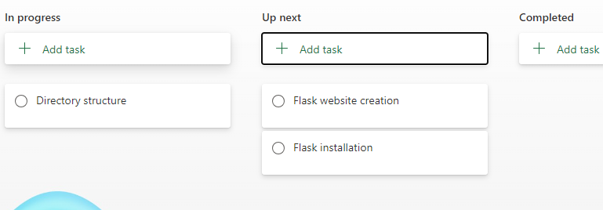
Component 1 (Trello screenshot)
need a directory structure to make sure the website will be functional and the way it is supposed to be.

Slide 21
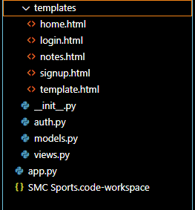
Component 1 v1
Directory structure

Slide 22
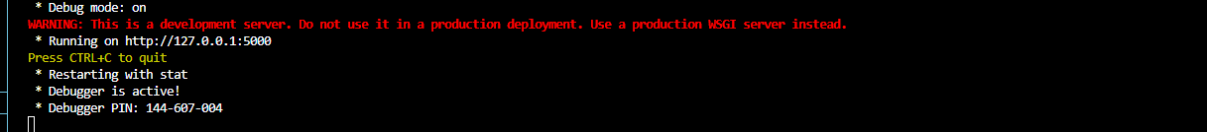
Component 2
Test Case | Expected Values
Run website | Website runs without error and provides an HTML link

Slide 23
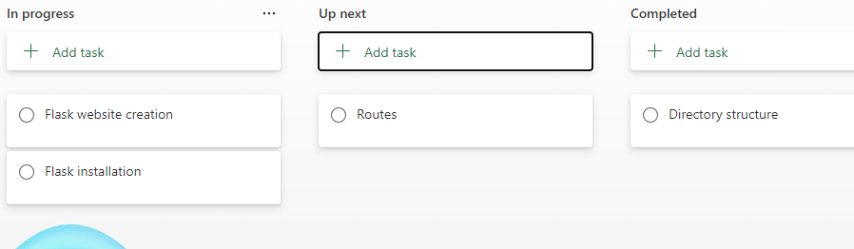
Component 2 (Trello screenshot)

Slide 24
Component 2 v1
Gives the link for the website

Slide 25
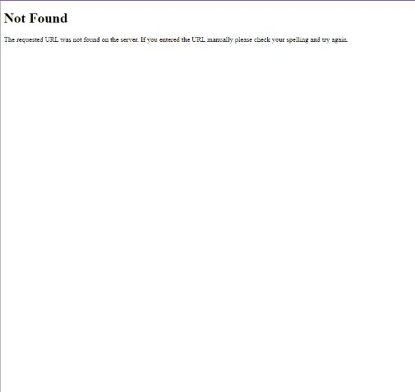
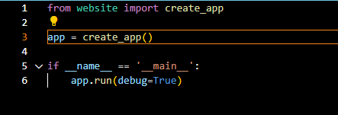
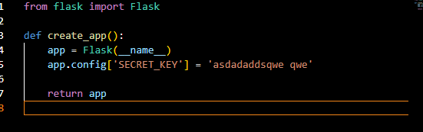
Component 2 v2
Site opens as expected, nothing on it currently though.

Slide 26
Component 3 - Test Plan (?and screenshot)
Test Case | Expected Values
Creating routes | I should be able to access the routes to login, logout, and signup

Slide 27
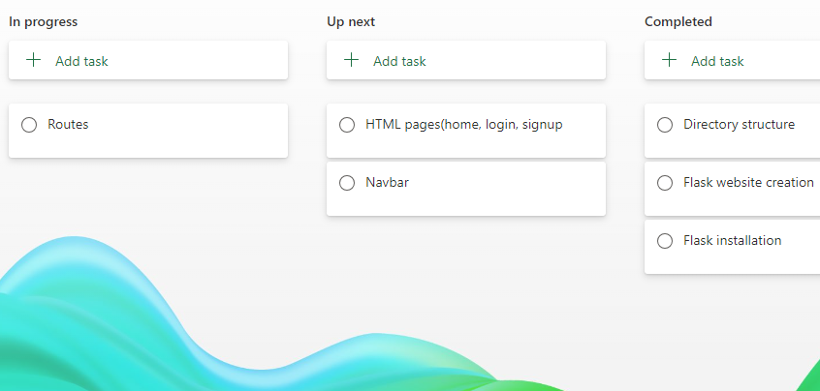
Component 3 (Trello screenshot)

Slide 28
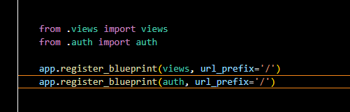
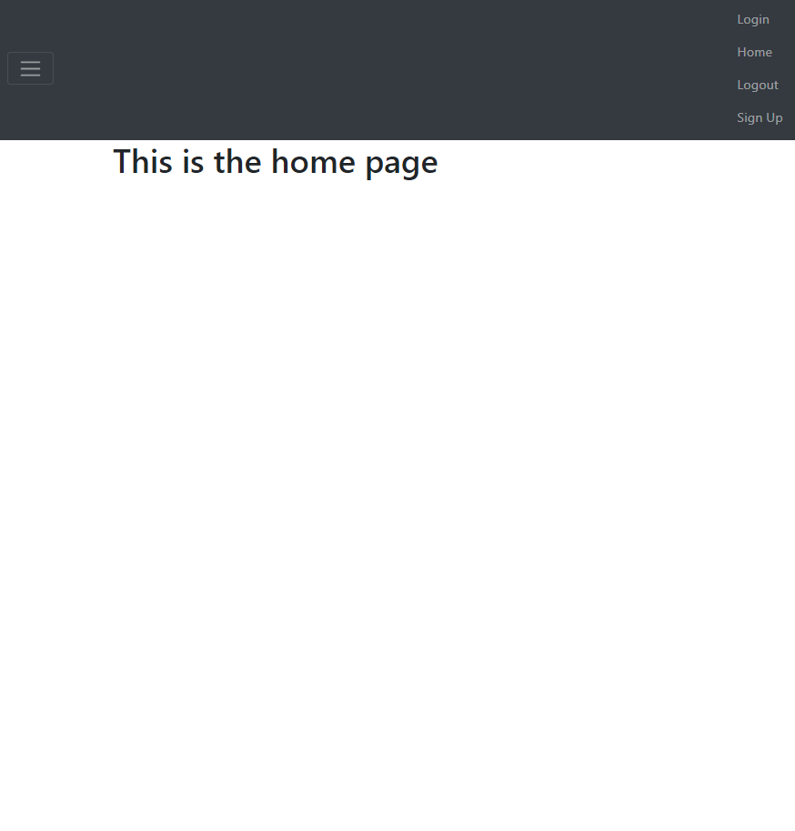
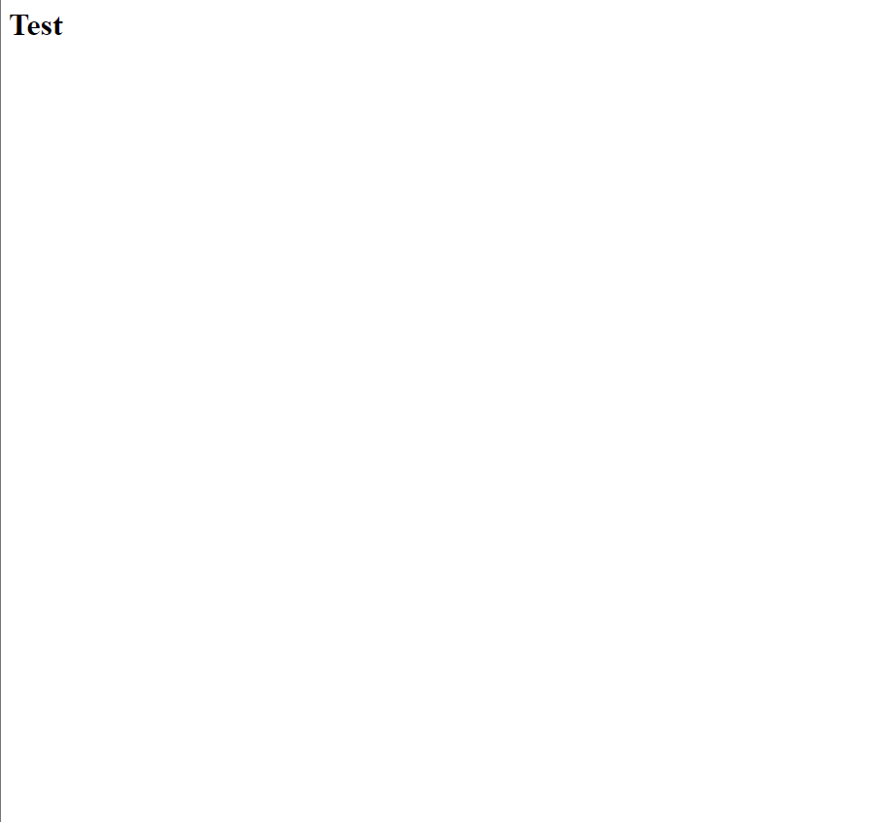
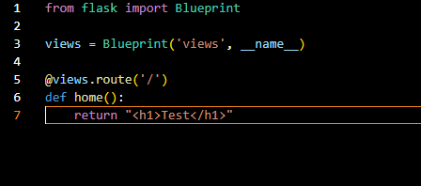
Component 3 v1

Slide 29
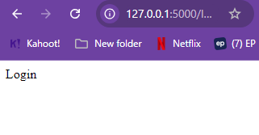
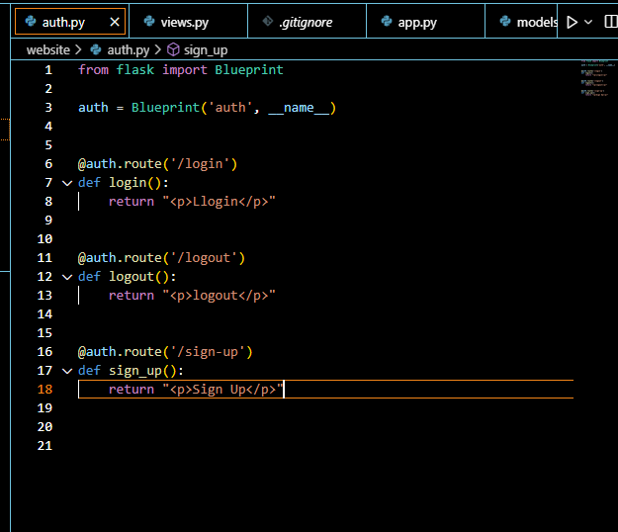
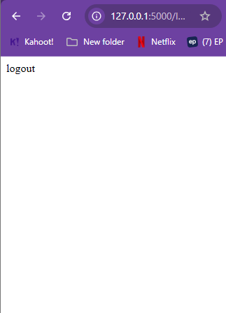
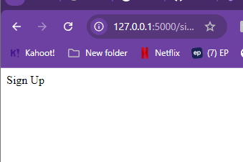
Component 3 v2

Slide 30
Errors faced
An error I am encountering is that when I run the website from app.py it does not display. - fixed
Encountering errors with views.py now
Error fixed: I wrote {% extends "template.html" %} instead of {% extends "base.html" %}

Slide 31
Component 4 - Test Plan (?and screenshot)
Test Case | Expected Values
Jinja Templating Language & HTML Templates | Navbar on the base.html, and should be able to access the other html pages – signup, login, logout

Slide 32
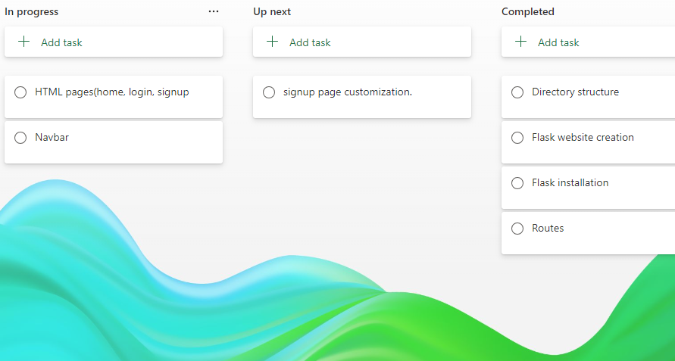
Component 4 (Trello screenshot)

Slide 33
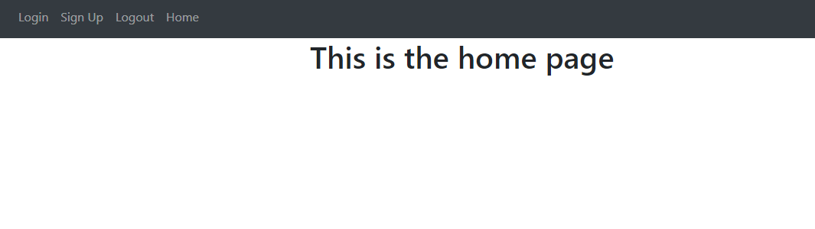
Component 4 v1
Navbar is done

Slide 34
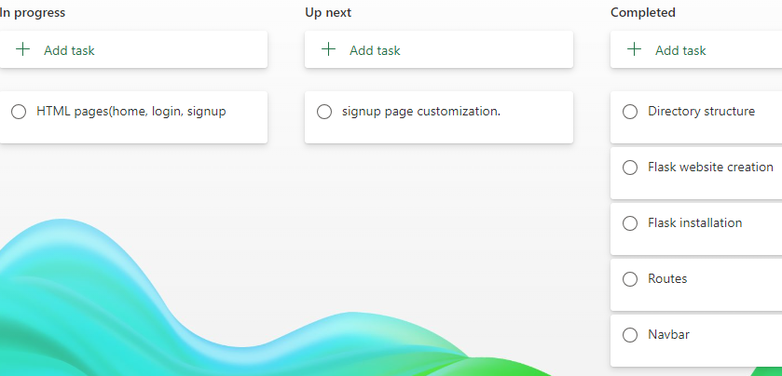
Component 4 v1 (Trello screenshot)

Slide 35
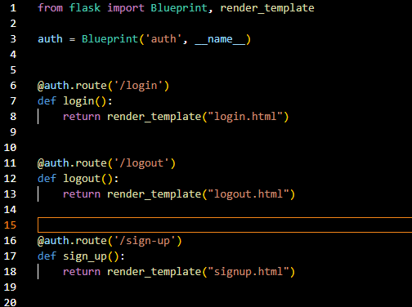
Component 4 v2
Linking all the the htmls with auth.py

Slide 36
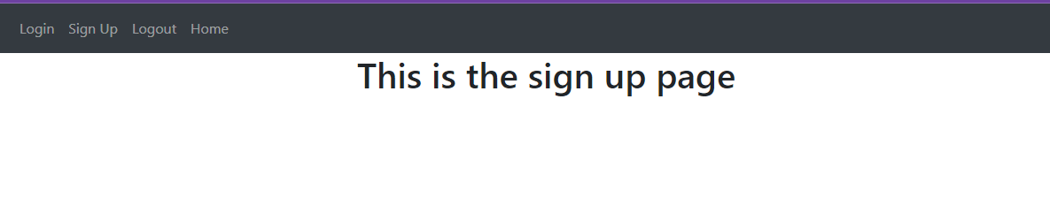
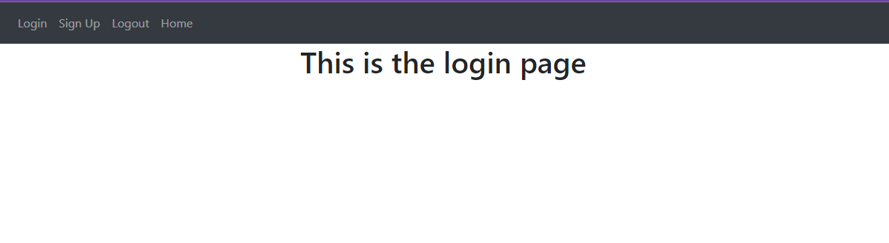
Component 4 v3
Putting text on all the htmls

Slide 37
Component 5 - Test Plan (?and screenshot)
Test Case | Expected Values
Signup page | Should show signup page with email, password, and first name

Slide 38
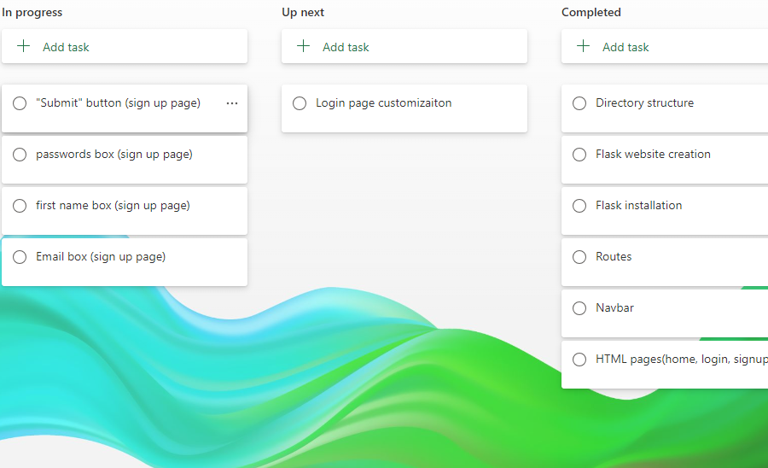
Component 5 (Trello screenshot)

Slide 39
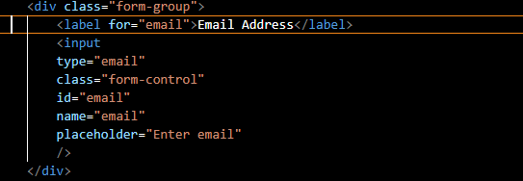
Component 5 v1
Email box

Slide 40
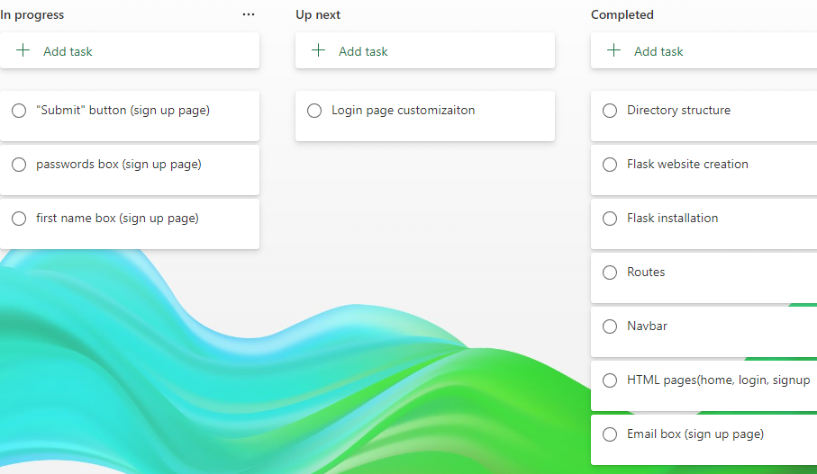
Component 5 v1 (Trello screenshot)

Slide 41
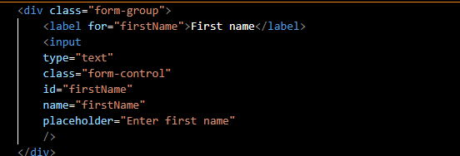
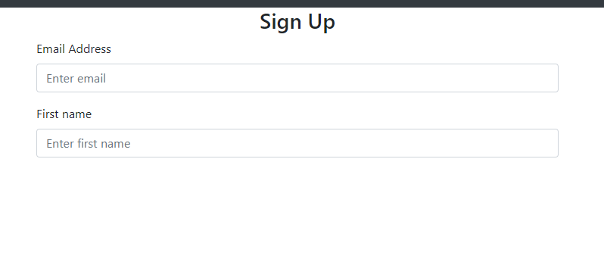
Component 5 v2
First name box

Slide 42
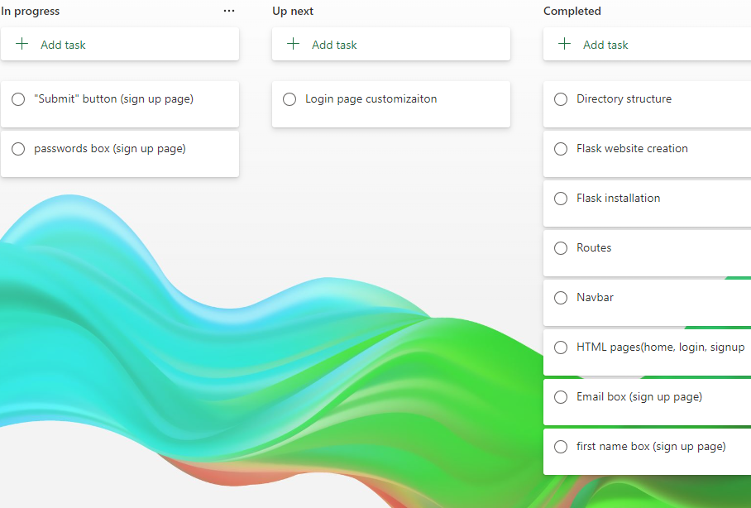
Component 5 v2 (Trello screenshot)

Slide 43
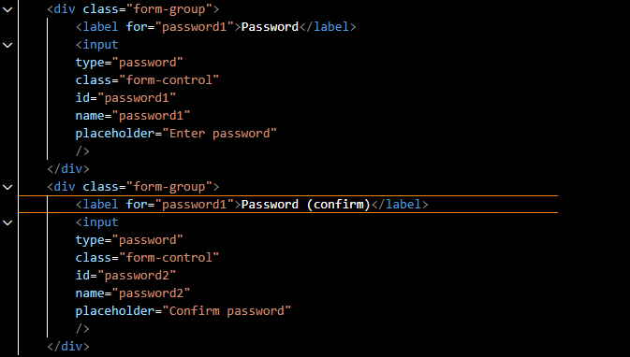
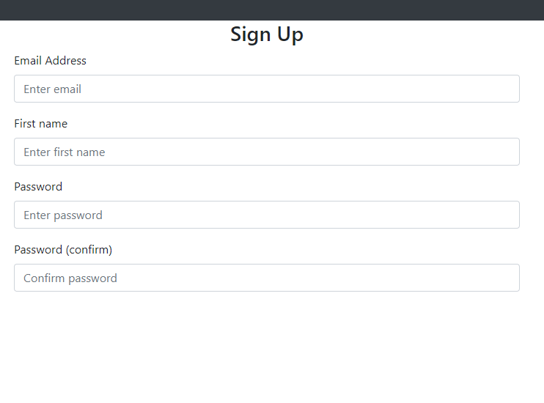
Component 5 v3
Passwords

Slide 44
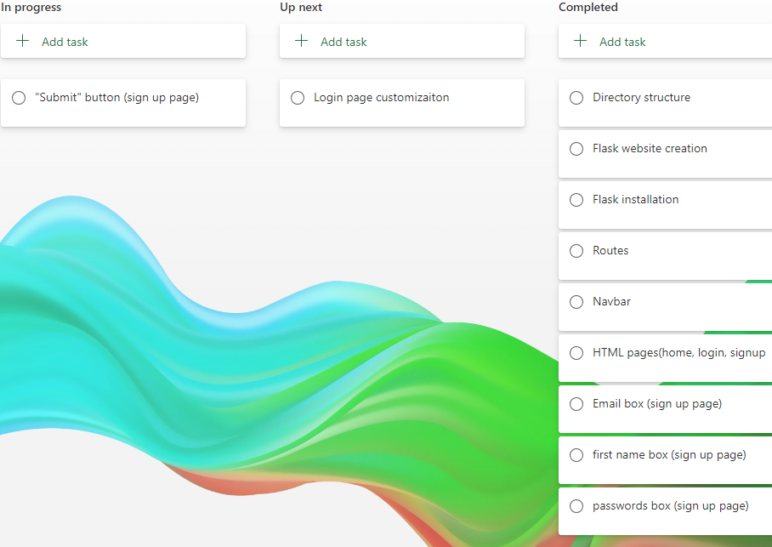
Component 5 v3 (Trello screenshot)

Slide 45
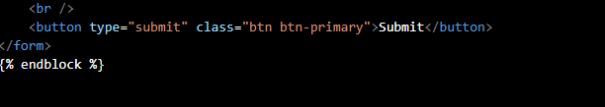
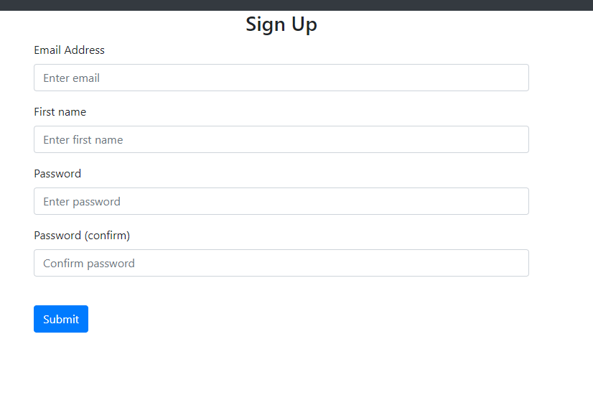
Component 5 v4
Sign up button

Slide 46
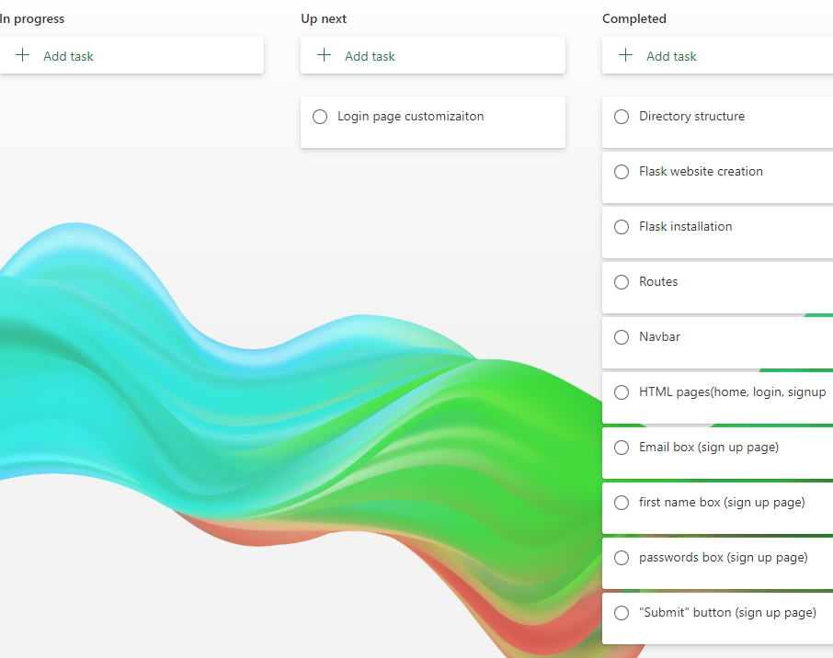
Component 5 v4 (Trello screenshot)

Slide 47
Component 6 - Test Plan (?and screenshot)
Test Case | Expected Values
Login page | Login page should be displayed – showing email and password, and should take to a new page

Slide 48
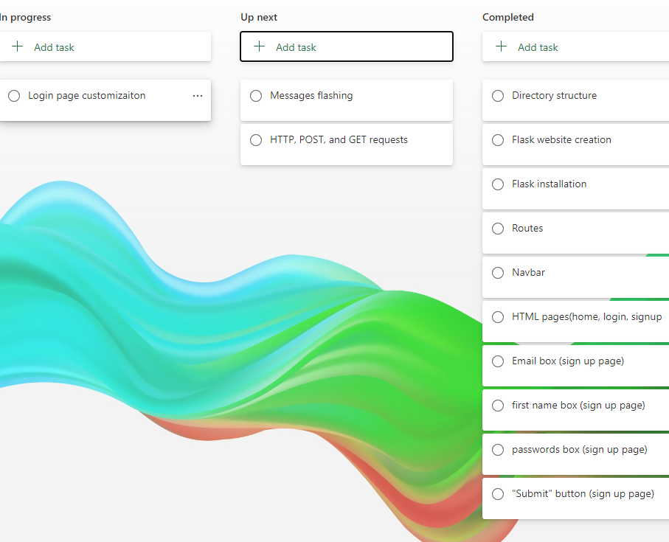
Component 6 (Trello screenshot)

Slide 49
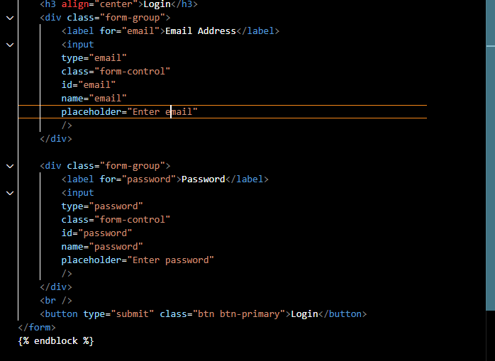
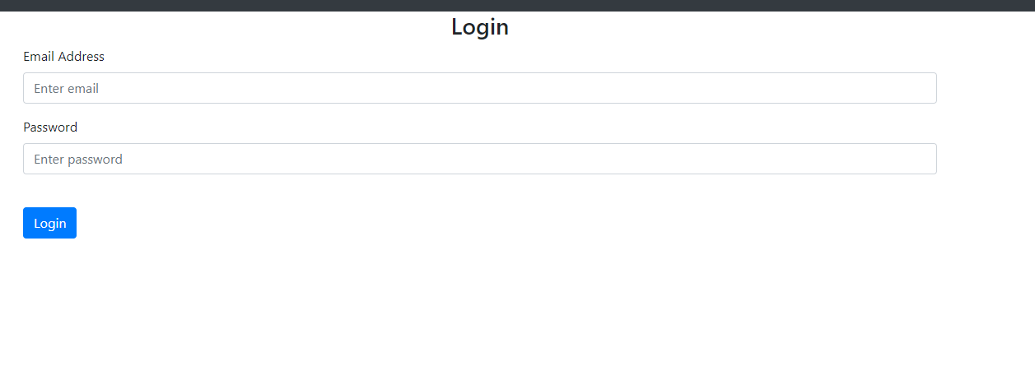
Component 6 v1
Login page – simple as all needed to do was copy and paste from signup and just change a few words

Slide 50
Component 7 - Test Plan (?and screenshot)
Test Case | Expected Values
HTTP requests & Handling post requests, and messages flashing | Website can run properly (should not show "method not allowed") should instead show if error is faced

Slide 51
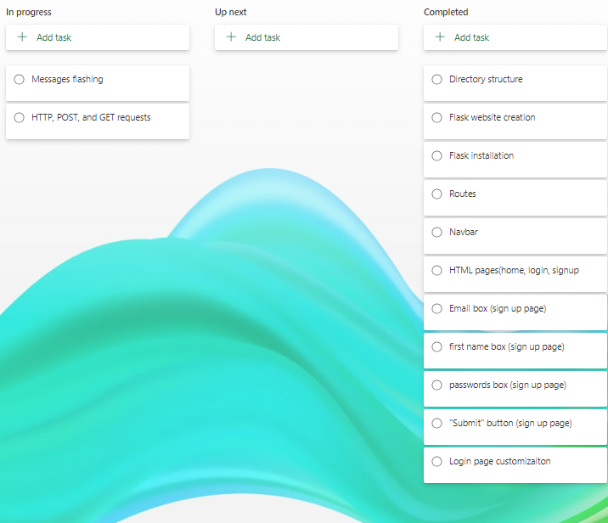
Component 7 (Trello screenshot)

Slide 52
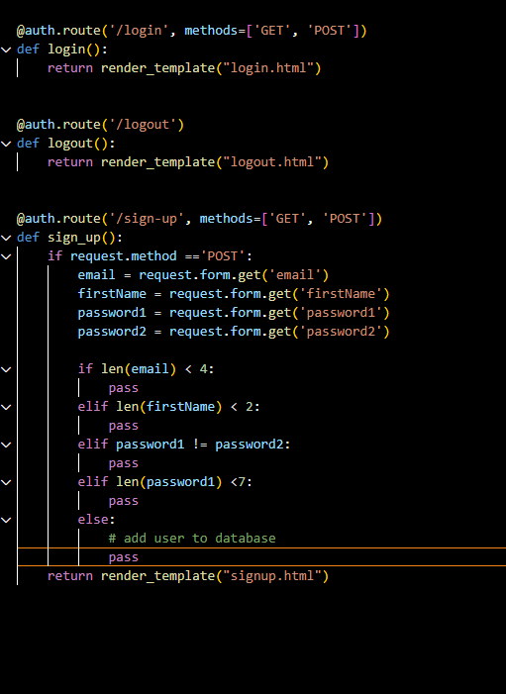
Component 7 v1
HTTP requests & Handling post requests
Now it will no longer show
(method now allowed)
Will not just do nothing,
until we do message flashing

Slide 53
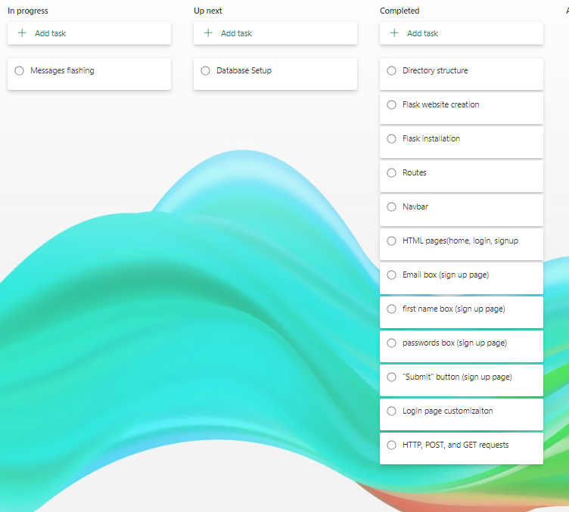
Component 7 v1 (Trello screenshot)

Slide 54
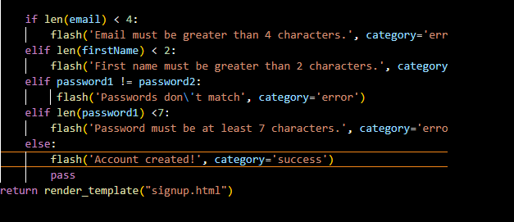
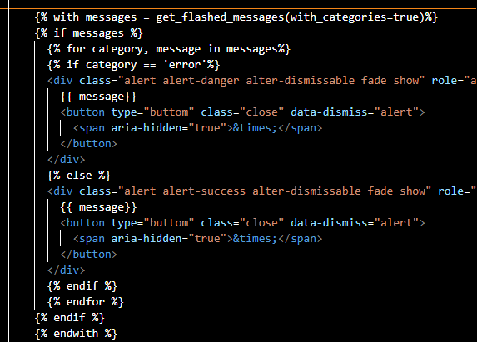
Component 7 v2
Messages flashing

Slide 55
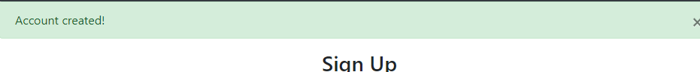
Messages flashing examples

Slide 56
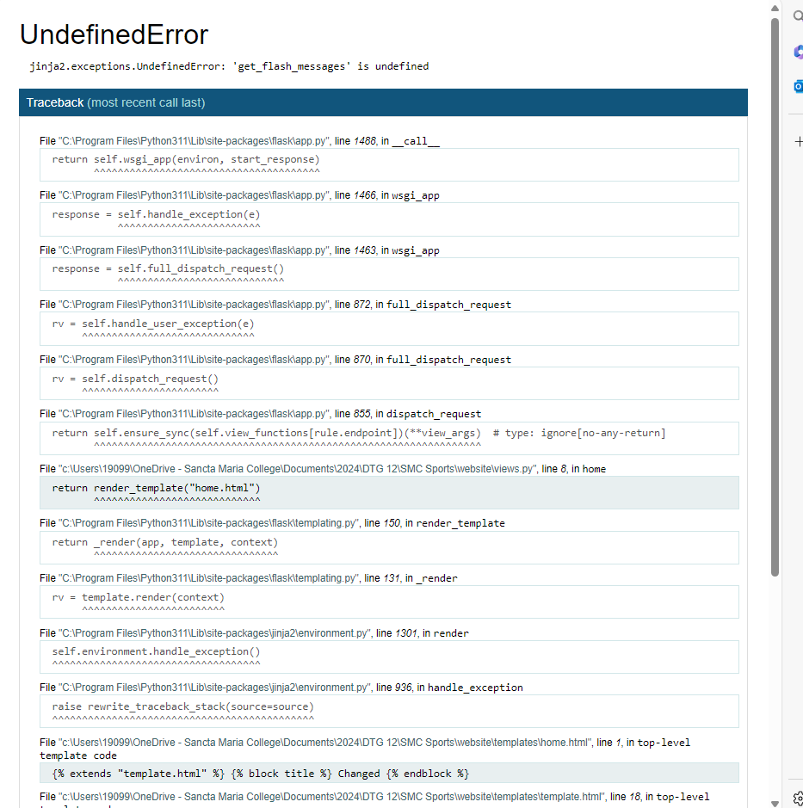
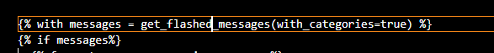
Errors faced
Fixed from get_flash_messages, get_flashed_messages

Slide 57
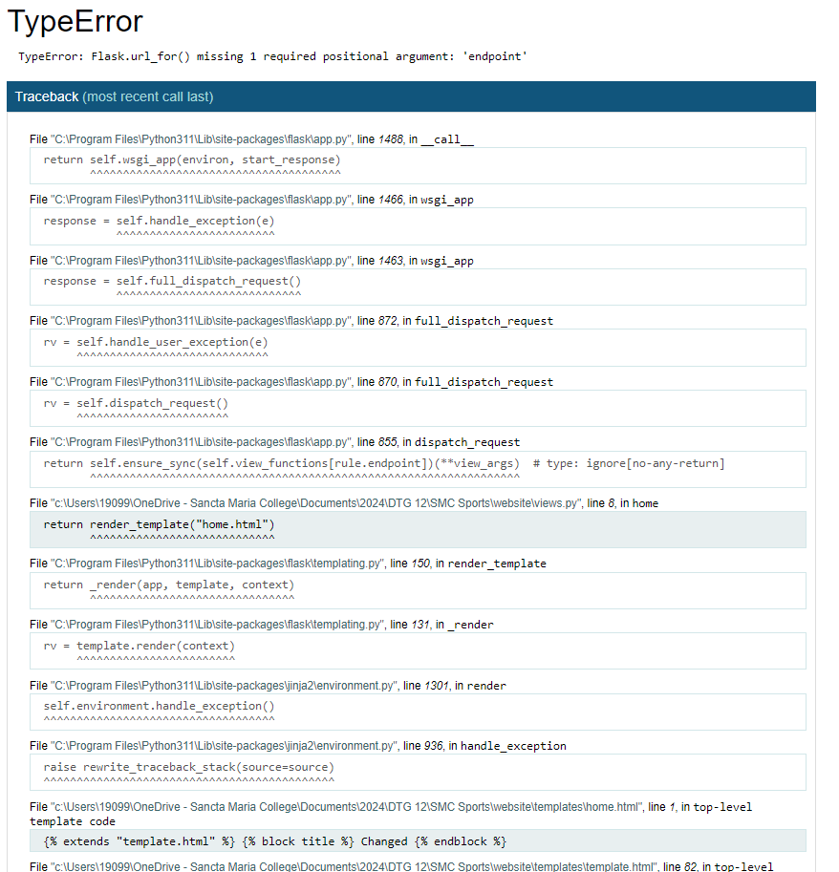
Now this error is coming up
Error fixed; problem was I had two </html>

Slide 58
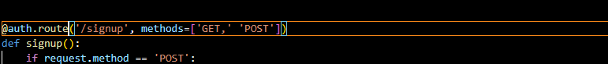
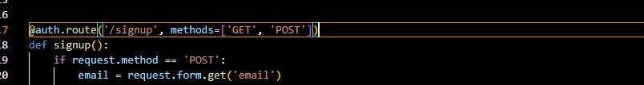
Error faced
Solution
The comma was not in

Slide 59
Component 8 - Database model creation
Test Case | Expected Values
Database setup | Accounts should be stored in the database

Slide 60
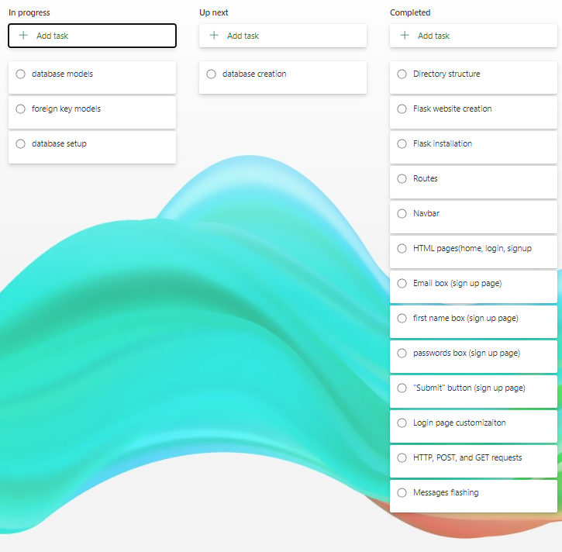
Component 8 (Trello screenshot)

Slide 61

Component 8 v1
Setting up the location of the database

Slide 62

Component 8 v2 (Trello screenshot)

Slide 63

Component 8 v2
Database Models

Slide 64

Component 8 v3 (Trello screenshot)

Slide 65

Component 8 v3
Foreign key models

Slide 66
Component 9 - Database model creation
Test Case | Expected Values
Create the Database | Database should be able to be accessed in website folder

Slide 67

Component 9 (Trello screenshot)

Slide 68

Component 9 v1
Defines models.py, need before we actually create the database

Slide 69

Error faced
Error was that it is case sensitive, being SQLAlchemy, I spelt it as SQLALCHEMY

Slide 70

Error faced
Error was that I forgot to put a . In front of models

Slide 71


Component 9 v2
Database is created

Slide 72
Component 10 - Creating new user accounts
Test Case | Expected Values
Creating new user accounts | User accounts should be stored in the database

Slide 73

Component 10 (Trello screenshot)

Slide 74

Errors faced
Error was that I needed to write "from . import db"

Slide 75


Component 10 v1
Created accounts show up on the database

Slide 76
Component 11 - Logging in users
Test Case | Expected Values
Logging in users and logging out | Login requirements should be set, eg cant use unknow email, etc. Users should be sent to the home page after logging in. Should not be able to see home and logout page without being signed in. Logged out users should only be able to see the login and sign up buttons.

Slide 77

Component 11 (Trello screenshot)

Slide 78


Component 11 v1
Making the login requirements

Slide 79




Slide 80

Component 11 v2(Trello screenshot)

Slide 81

Component 11 v2
After logging it should reroute to home page

Slide 82

Component 11 v3 and v4(Trello screenshot)

Slide 83

Component 11 v3
Logged out users should not be able go home page and logout
Logged in users should not be able to go sign up and login

Slide 84

Component 11 v4
Navbar should only display signup and login for anonymous users
Navbar should only display logout and home for current user

Slide 85



Slide 86
Component 12 - Notes.html
Test Case | Expected Values
Add notes | Notes should be able to be added and seen.

Slide 87

Component 12(Trello screenshot)

Slide 88


Component 12 v1 - Notes.html
Notes.html is added

Slide 89
Component 12 v1(Trello screenshot)

Slide 90


Component 12 v2 - Adding notes

Slide 91



Component 12 v3 – deleting notes

Slide 92

Notes can now be deleted

Slide 93

Component 12 v2 and v3(Trello screenshot)

Slide 94
Component 13 -
Test Case | Expected Values
separating the home page and notes page | Currently the home page is the notes page, they should be split up

Slide 95

Component 13(Trello screenshot)

Slide 96

Component 13 v1
Home page now = notes page
And separate new page will be made for home

Slide 97

Component 13 v2
Linking the New Notes page to the navbar

Slide 98

Component 13 v3 v4 v5(Trello screenshot)

Slide 99


Component 13 v3
New home page

Slide 100


Component 13 v4

Slide 101

Component 13 v5
Writing the home page

Slide 102


Component 13 v6 – home page images

Slide 103
Component 14 -
Test Case | Expected Values
color scheme and fonts | Background colors and font should be changed to add life and should add some aesthetic to the website.

Slide 104

Component 14(Trello screenshot)

Slide 105

Component 14 v1 – Creating the CSS file & image folder.

Slide 106

Component 14 v2 – Linking the CSS File to HTML website.

Slide 107

Component 14 v3(Trello screenshot)

Slide 108
Component 14 v3 – testing out background colors

Slide 109

Option 1 - red
Terrible
Looks ugly
Doesn’t fit

Slide 110

Option 2 - yellow
A bit better but still not
Good looking
For final option we will
Try a more neutral color

Slide 111

Option 3
Will go with this
Because the colors are neutral
And fit with the text and images

Slide 112
Component 14 v4 – notes colors

Slide 113

Component 14 v4(Trello screenshot)

Slide 114

Option 1 - Green
Doesn’t fit with the background

Slide 115

Option 2 - Yellow
Looks better but still looks out of place

Slide 116

Option 3- beige ivory
I'm picking this one because it looks aesthetic and fits with the background

Slide 117
Component 14 v5 – Note font
Currently I have it set to
But I will test out other fonts

Slide 118

Component 14 v4(Trello screenshot)

Slide 119

Option 2
Looks too much like the first one

Slide 120

Option 3:
I'm going with option 3 because It readable, modern, and looks professional

Slide 121

Error with notes:
The "/" would redirect me to home everytime I deleted the note, the solution was to change it to "notes"

Slide 122

User feedback 1
Before
I got my friend Stephen to test my website and make some recommendations, first off, he found the bug with the notes that I talked about in the previous slide, and he also recommended me to change the background color as it was stale. He recommended I use a neutral color as that would blend in the most.
After:

Slide 123

User feedback 2:
After
I got my other friend Frank to look at my code, and he said that since I changed the background of the pages I should change the note background and font too, we went through 3 different colors and fonts but collectively settled on beige ivory and gill sans.
Before:

Slide 124
Version Control Evidence
Your version control evidence should go here. This could be in the form of annotated screenshots which show you you managed this process or you could make a brief screencast explaining how you implemented version control.
Notes:
Your version control evidence should go here. This could be in the form of annotated screenshots which show you you managed this process or you could make a brief screencast explaining how you implemented version control.

Slide 125
Version Control Section Section
(I had to duplicate my original one and redo it as my original one had not been linked showing the progress on the github desktop
https://github.com/lucas123454653/Notes-app

Slide 126

Version Control Section Section

Slide 127


Slide 128
Python Code Coventions & functional testing
Show screenshot of PEP8 testing both before and after.

Slide 129


Functional testing evidence 1 – Password meeting requirements
Expected outcome | Actual outcome
If the password requirements are not met, eg if password 1 and 2 do not match or the password is under 7 characters it will not let the user sign up | Worked correctly, wont let user create account

Slide 130

Functional testing evidence 2 – Signing up
Expected outcome | Actual outcome
If the user meets all the requirements needed to make an account their details will be put in the database | Worked correctly, details are stored in the database

Slide 131

Functional testing evidence 3 – Logged in
Expected outcome | Actual outcome
If the user is logged in they should not be able to see the sign up or log in buttons, just home, logout, and notes. | Worked correctly, logged in users can see notes and logout, but not sign up or login

Slide 132

Functional testing evidence 4 – Logged out
Expected outcome | Actual outcome
If the user is logged out they should only be able to see the sign up, log in and home buttons, not logout and notes. | Worked correctly, logged out users cannot access the notes tab and are forced to sign in or sign up

Slide 133


Functional testing evidence 5 – Adding and deleting notes
Expected outcome | Actual outcome
Logged in users should be able to add and delete notes with no issue | Worked correctly.

Slide 134


Functional testing evidence 6 – logging in
Expected outcome | Actual outcome
If user tries logging in with details used on the sign-up page it should work. | Worked correctly.

Slide 135
Functional testing evidence 7 – Pop up messages
Expected outcome | Actual outcome
Pop up messages should be able to be deleted with an X | Worked correctly.

Slide 136

Python convention testing (PEP8) Views.py (before)
Notes:
Your version control evidence should go here. This could be in the form of annotated screenshots which show you you managed this process or you could make a brief screencast explaining how you implemented version control.

Slide 137

Python convention testing (PEP8) Views.py (after)
Notes:
Your version control evidence should go here. This could be in the form of annotated screenshots which show you you managed this process or you could make a brief screencast explaining how you implemented version control.

Slide 138

Python convention testing (PEP8) init.py before
Notes:
Your version control evidence should go here. This could be in the form of annotated screenshots which show you you managed this process or you could make a brief screencast explaining how you implemented version control.

Slide 139

Python convention testing (PEP8) init.py (after)
Notes:
Your version control evidence should go here. This could be in the form of annotated screenshots which show you you managed this process or you could make a brief screencast explaining how you implemented version control.

Slide 140

Python convention testing (PEP8) models.py (before)
Screenshot of errors
Notes:
Your version control evidence should go here. This could be in the form of annotated screenshots which show you you managed this process or you could make a brief screencast explaining how you implemented version control.

Slide 141

Python convention testing (PEP8) models.py (after)
Notes:
Your version control evidence should go here. This could be in the form of annotated screenshots which show you you managed this process or you could make a brief screencast explaining how you implemented version control.

Slide 142


Python convention testing (PEP8) auth.py (before)
Notes:
Your version control evidence should go here. This could be in the form of annotated screenshots which show you you managed this process or you could make a brief screencast explaining how you implemented version control.

Slide 143


Python convention testing (PEP8) auth.py (after)
Notes:
Your version control evidence should go here. This could be in the form of annotated screenshots which show you you managed this process or you could make a brief screencast explaining how you implemented version control.

Slide 144
Discusses how the information from planning, testing and trialling of components assisted in the development of a high-quality outcome
To develop a high-quality notes app, I focused on three key implications: aesthetics, functionality, and privacy. Each of these aspects played a crucial role in shaping the final product and ensuring a positive user experience. The first aspect I considered was aesthetics. A visually appealing design can make users more interested in using the app. I aimed for a clean and modern look that is easy to navigate. This included choosing a nice color scheme, using clear fonts, and organizing the layout so that it doesn’t feel cluttered. Privacy is also another important implication for a high quality notes app, as protecting user data is important in any application, especially one that stores personal notes. I implemented security measures, such as database encryption to safeguard user information. This ensures that notes remain confidential and are accessible only to the user, and also other data such as passwords, names, and emails don't get leaked. The second important aspect was functionality, which means how well the app works. The app needed to allow users to create and delete their notes easily. To make sure everything worked smoothly, I tested the app during development. This involved checking for bugs, and making sure everything works as it is supposed to By prioritizing functionality, I wanted to provide users with a reliable tool that meets their needs without causing frustration. Now after i identified these implications i started planning my code. I created files of the items i wanted and planned everything out using Microsoft planner, ensuring i stayed organized. I would sort out my code accordingly into seperate files so i could make sure everything ran smoothly, to help this, i constantly tested and trialed all my code as i worked on different components, every time i added something new i would run it see if there were any errors and correct them if there were, i would also have my friends test my thing from time to time to see how people from an outside perspective would use it and if they were to run into any errors that slipped past me, which they in fact did. Finally after i finished the code i tested it again using functional testing and PEP8, which confirmed my code was valid and wouldn't break. Testing, trailing, and planning ensured that i had produced a high quality notes app program
Notes:
Discusses how the information from planning, testing and trialling of components assisted in the development of a high-quality outcome

